Slide 1

Capstone Project

Slide 2



Personal BACKGROUND
Name : Madhan Adithya KR
Past Experience : Technically NO,
But I have some Knowledge on React, Node.js, Large Language Models (LLMs), FastAPI, MongoDB, and PostgreSQL.
Qualification : B.E Computer Science and Engineering
Career Summary :
I started my career at Ascendion in July 2025. I was initially trained on the MERN stack. Later, I was assigned to the Citi Project, where I gained experience with FastAPI, MongoDB, and GenAI tools like LangGraph, LangChain, and various Large Language Models.
www.collaberadigital.com

Slide 3


Key Takeaways/Learnings from the Program (HTD)
Strong Testing Foundation – Gained hands-on experience in manual, automation, functional, and non-functional testing.
Real-World Agile Practices – Applied Agile, Scrum, and Jira effectively for end-to-end test lifecycle management.
Automation Skills – Built automation frameworks using Selenium (Java & Python) using maven, Page Object Model, logs, reports and executed scripts with JUnit, TestNG & PyTest.
API & Mobile Testing Exposure – Practiced API testing with Postman, Newman and mobile automation using Appium.
DevOps & CI/CD Integration – Gained knowledge on Integration using the tools like Git, Jenkins.
Performance Testing – Learned essentials of JMeter like making CRUD requests, samplers, listeners, config Elements and creating reports.

Slide 4

Problem Statement of the Capstone Project
Automate and validate key workflows for the TakeuForward application across UI, API, and performance layers.
Implement Selenium Java automation for user scenarios, API testing with Postman/Newman, and performance testing using JMeter.
Integrate test execution with Jenkins CI and maintain code in GitHub for version control.
Use Jira with Xray plugin for comprehensive test management, reporting, and sprint tracking.

Slide 5
Reference Links
GitHub Repository: madhanadithya/madhanadithya-Capstone-hp-training-may2025 Jira project Link: Sprint 2 - Api testing - HCM board - Scrum Board - Jira Web-Application: https://takeuforward.org/ API-Endpoint: Local Host using Json-server Base url : http://localhost:3000
End-points: /users, /products, /orders

Slide 6
JIRA
Created a project in Jira with 3 epics: Selenium Java Automation, API Testing, and Performance Testing using JMeter.
Created stories and tasks for those epics.
Using the Xray plugin, created preconditions, test cases, and executed them.
Created filters to display only specific issue types.
Created a dashboard with multiple gadgets to get a clear overview of the sprint, tasks, and test executions.
Jira project Link: Sprint 2 - Api testing - HCM board - Scrum Board - Jira

Slide 7
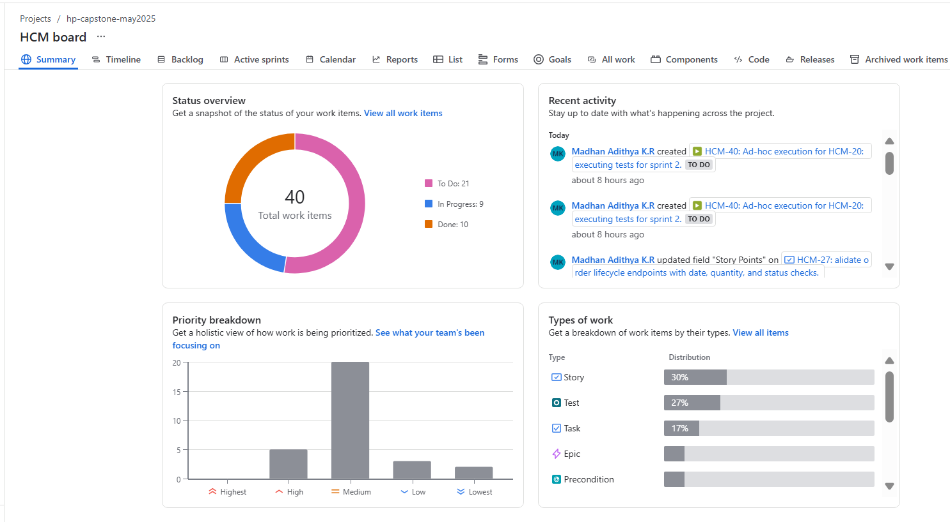
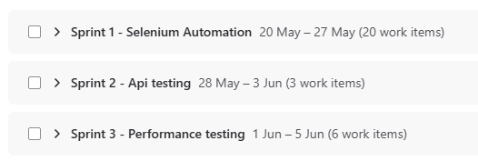
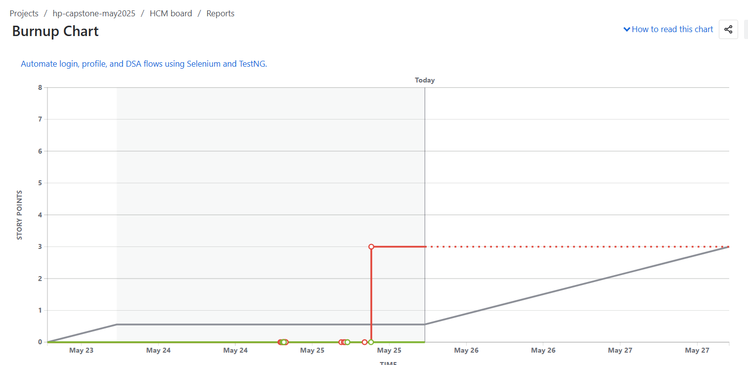
Summary Page and Sprints
Sprints
Summary
Burn-up chart

Slide 8
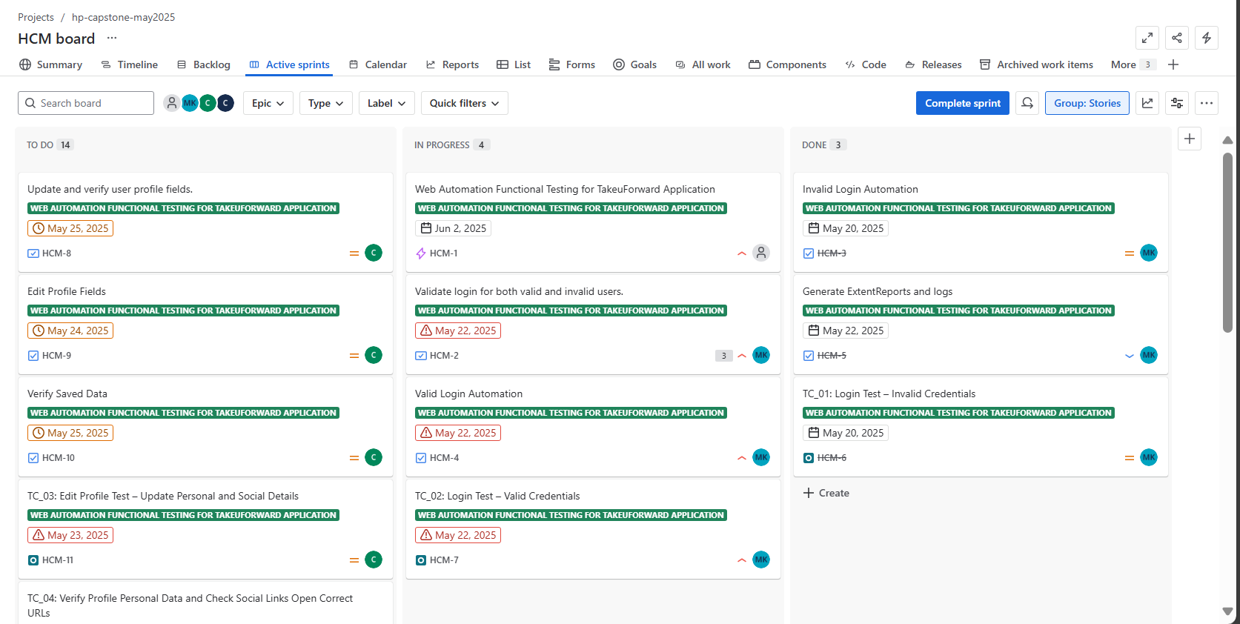
Sprint for My Selenium Project - TakeuForward

Slide 9
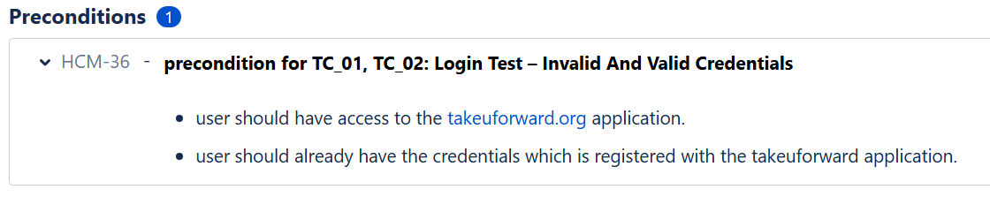
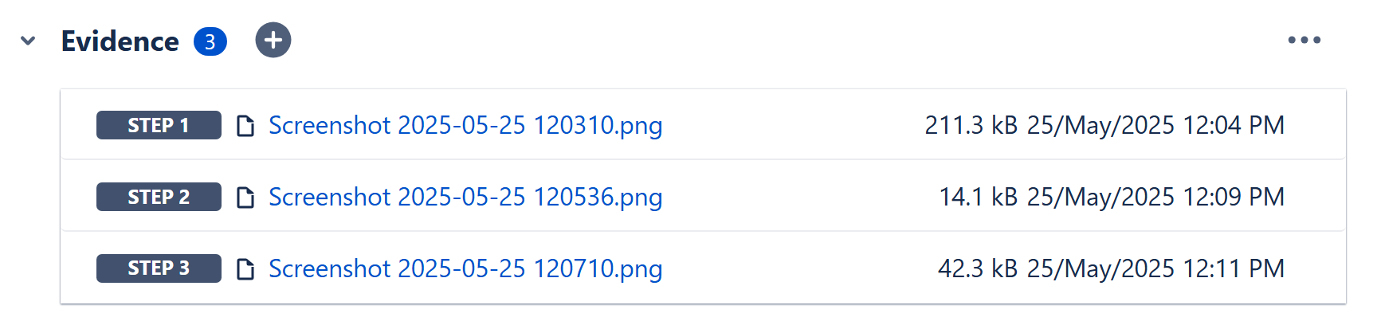
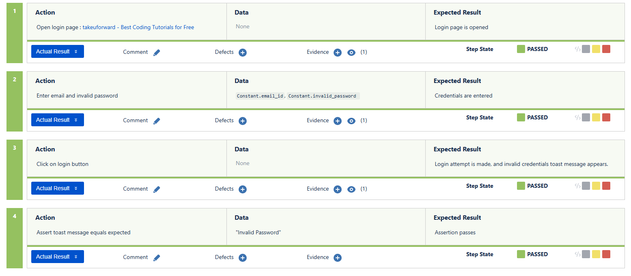
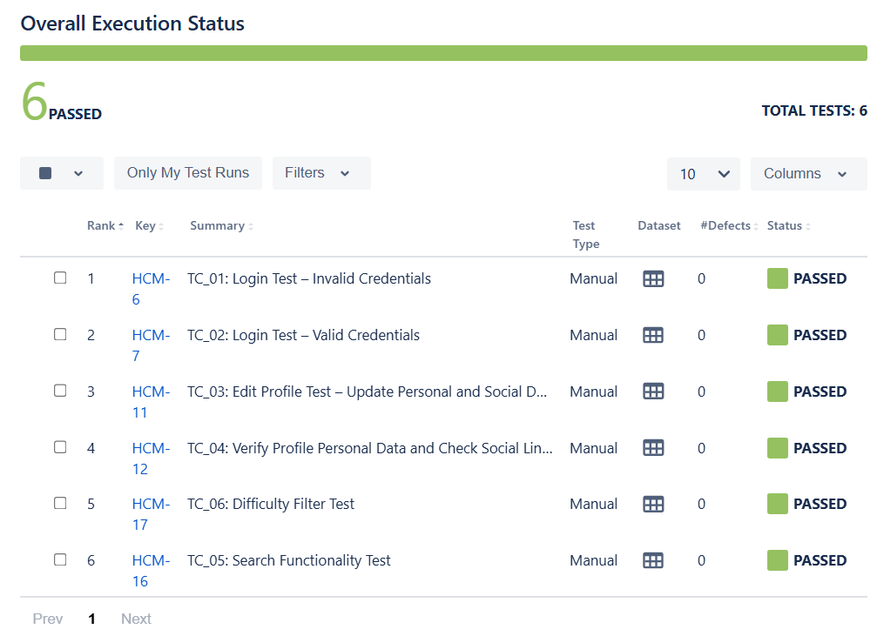
sample precondition, test executions and Evidence

Slide 10
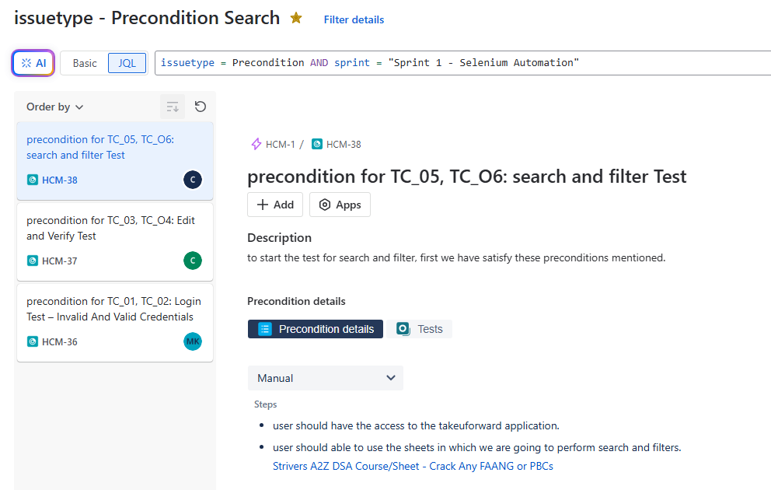
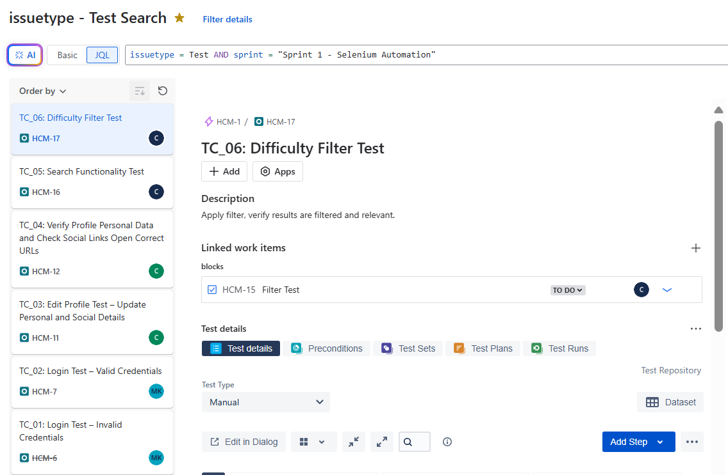
JIRA Filters
Filter to display only the “preconditions Issue-type” from the Sprint - 1 “Selenium Automation”
Filter to display only the “test Issue-type” from the Sprint - 1 “Selenium Automation”

Slide 11
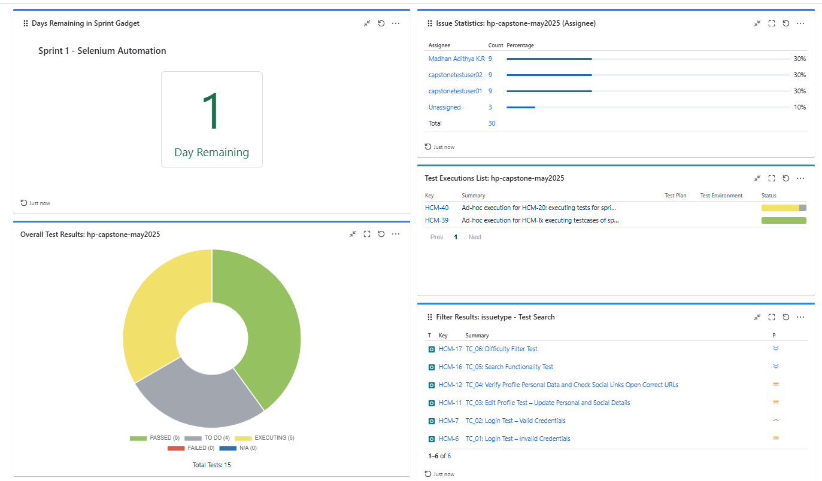
Dash Board

Slide 12
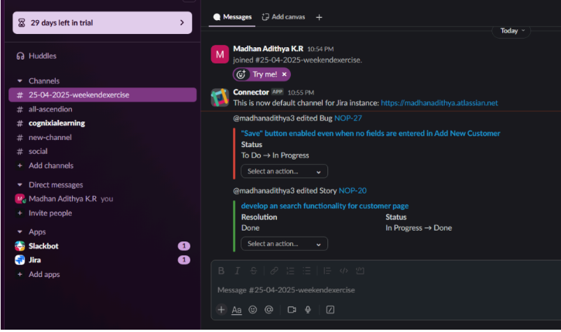
Slack Integration

Slide 13
Selenium Java Automation Test
1. Automated key user workflows on takeuforward.org
2. Validated login (valid/invalid users)
3. Edited and verified user profile fields
4. Implemented search & difficulty filter testing
5. Used TestNG, Page Object Model, log4j, Extent Reports, screenshots and also used Apache-poi Data Driven
Demo video Drive Link:
https://drive.google.com/file/d/12rv6VtvZ0xqmwl3dHPskHfi2nsLURHTL/view?usp=drive_link

Slide 14
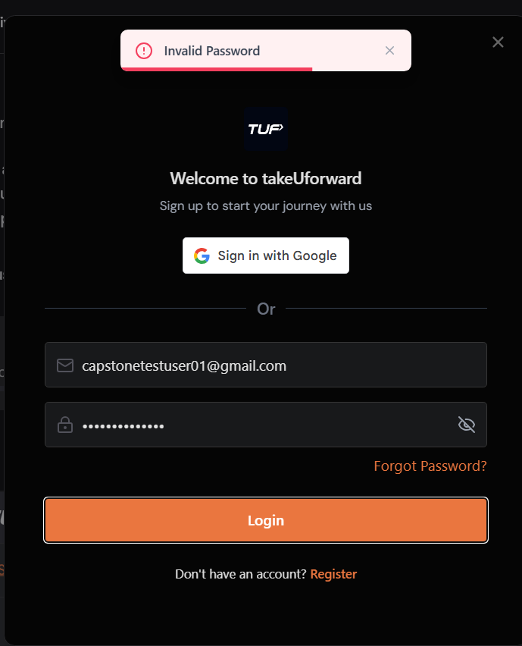

Expected Results
TC_01 : Invalid Login Test
TC_02: Valid Login Test

Slide 15
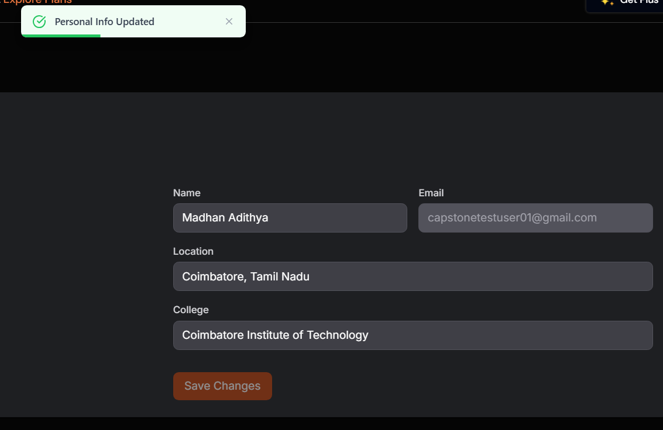
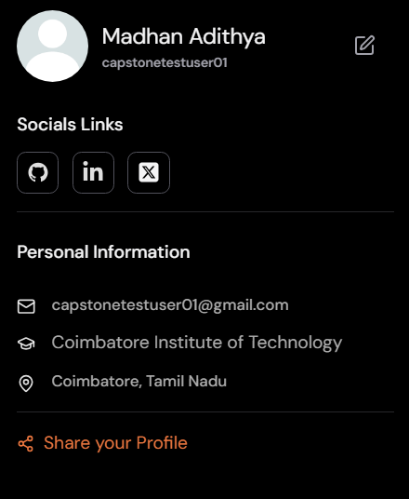
Expected Results
TC_03 : Edit Profile Test
TC_04: Verify Updated Profile Test

Slide 16
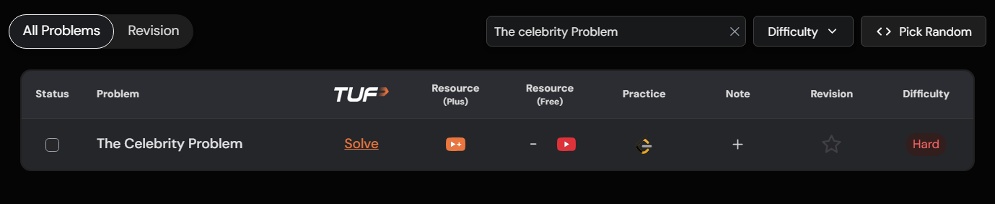
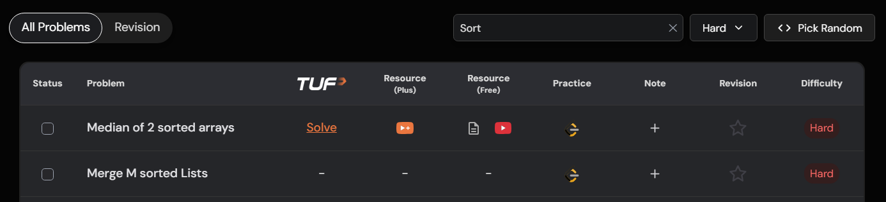
Expected Results
TC_05 : Search Test
TC_06: Filter Test

Slide 17
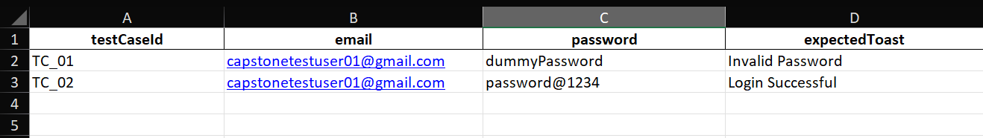
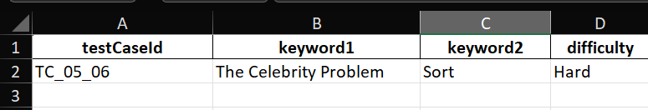
Excel Data for Data Driven Approach
sheet : Login
Sheet: Pofile
Sheet: Search

Slide 18
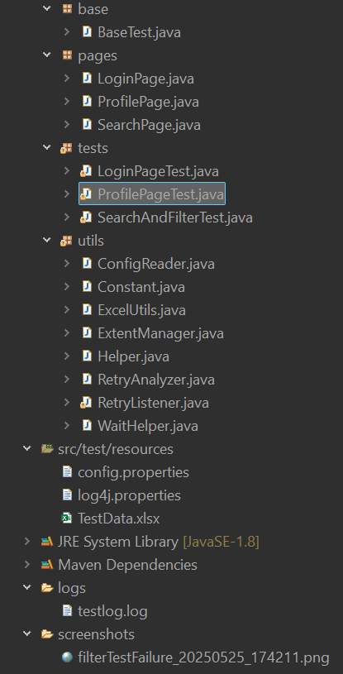
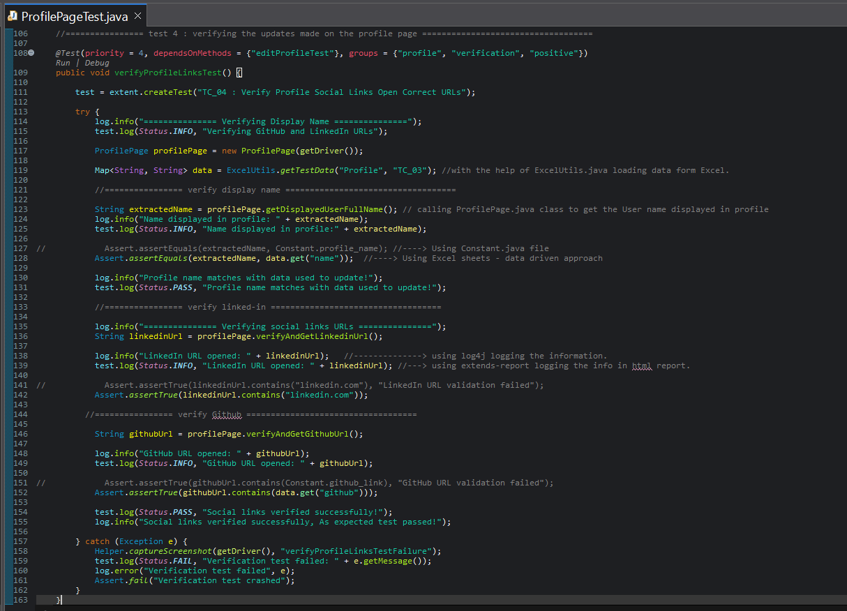
Sample Test Code Snippet from my Project
ProfilePageTest.java
Project File Structure

Slide 19
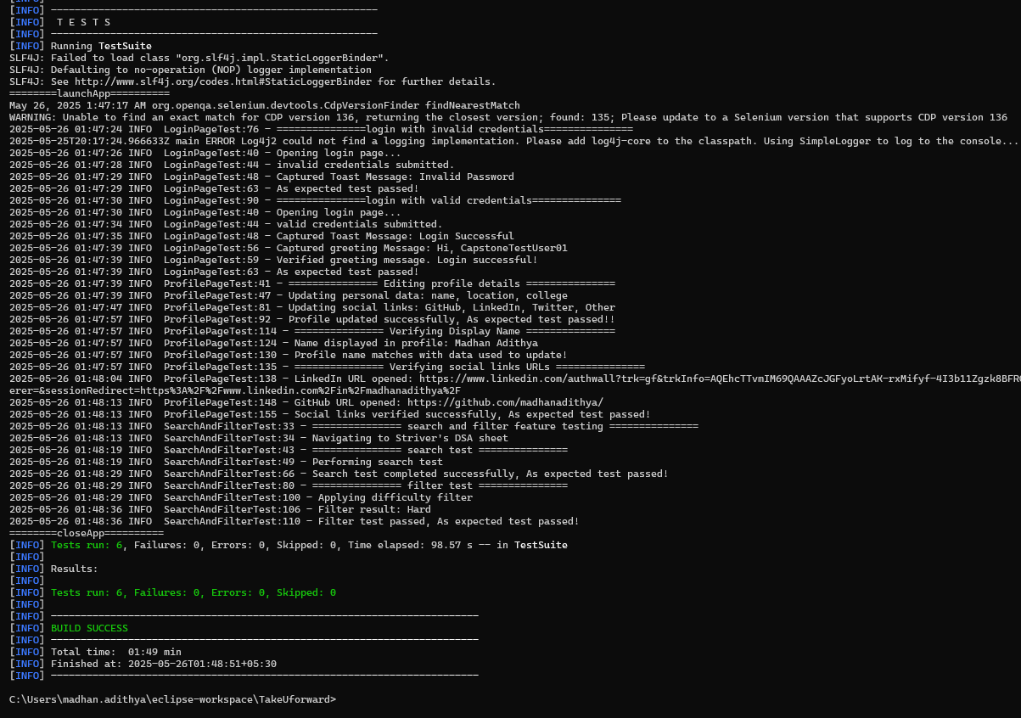
Execution in CLI : Using “mvn test”

Slide 20
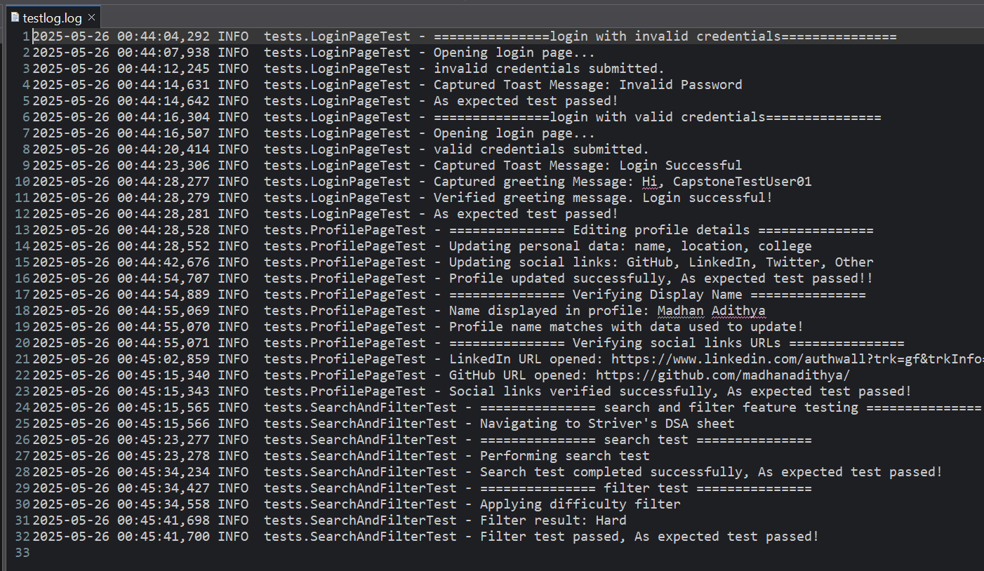
Logs using log4j

Slide 21
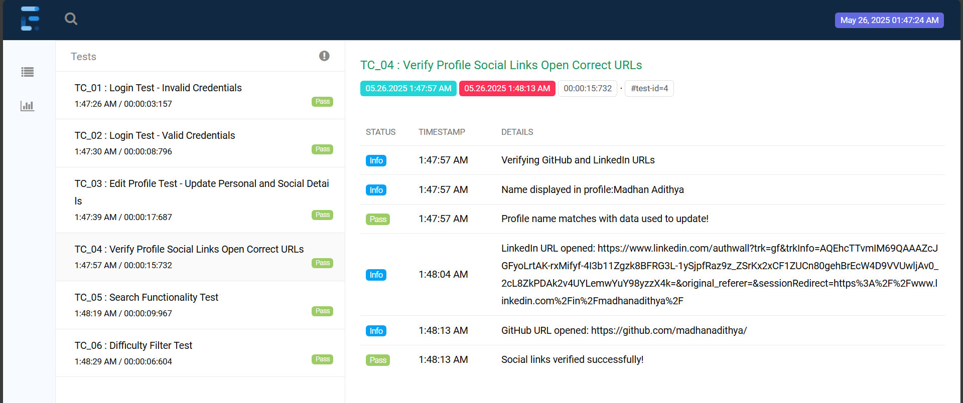
Extent Report

Slide 22
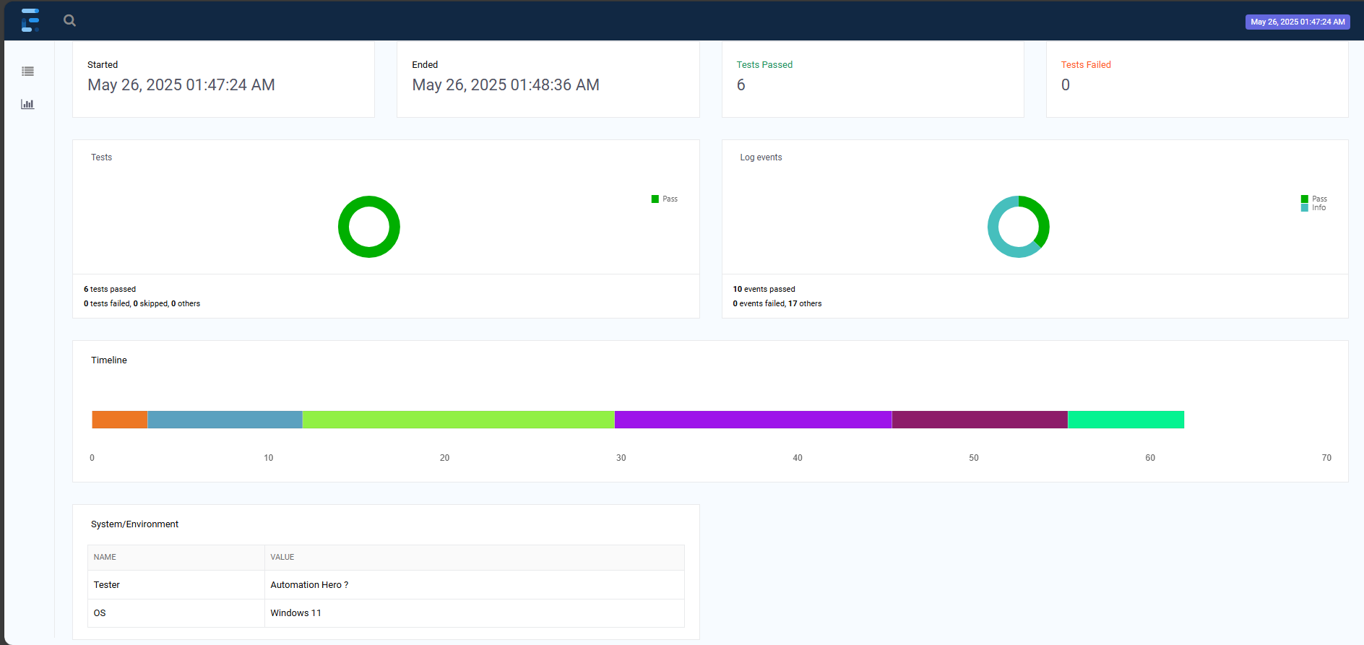
Extent Report

Slide 23
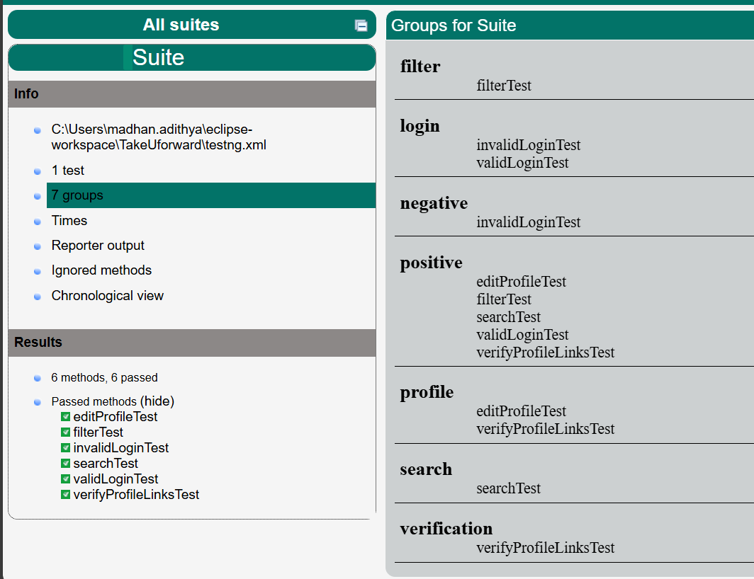
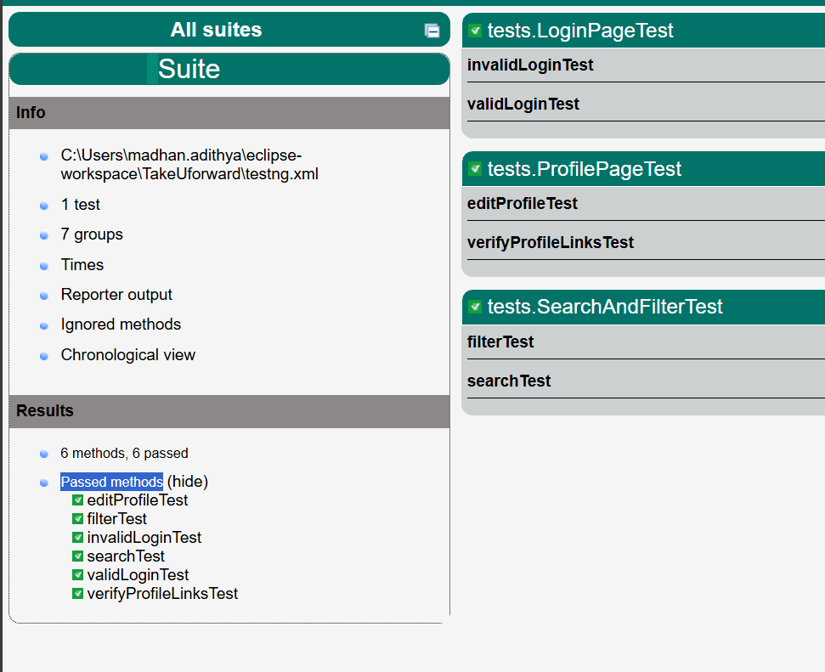
Surefire-Reports
Tags/Groups
Passed Tests - All cases passed

Slide 24
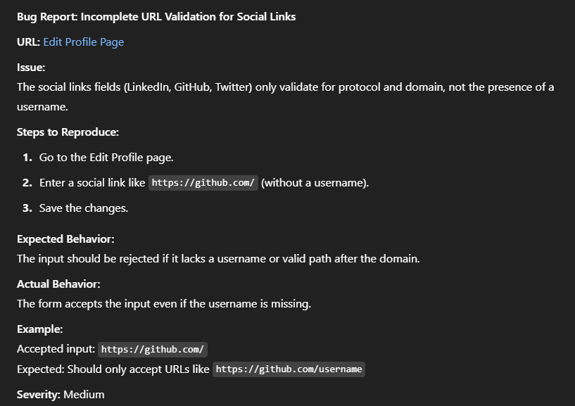
Bug Found:
I think they haven't fixed this bug yet because it might not be a current business priority them.

Slide 25
API Testing Using Postman And Newman
1) Created db.json with endpoints: users, products, orders
2) Performed full CRUD operations via Postman for all 3 Endpoints.
3) Validated the requests using Scripts.
4) Executed via Newman CLI with reports
Share Collection via API :
https://api.postman.com/collections/37293848-1fc82365-385e-4862-a884-48ed842cc49f?access_key=PMAT-01JW4Q5KN194XJKJRMY72CPBNZ

Slide 26
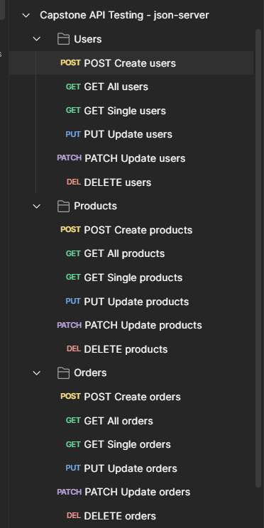
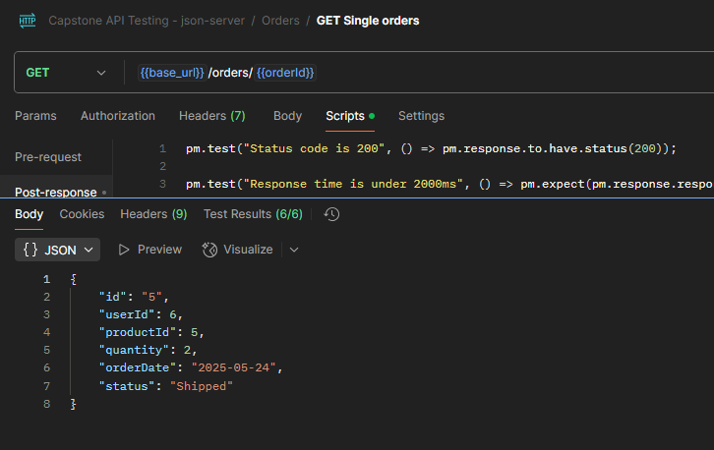
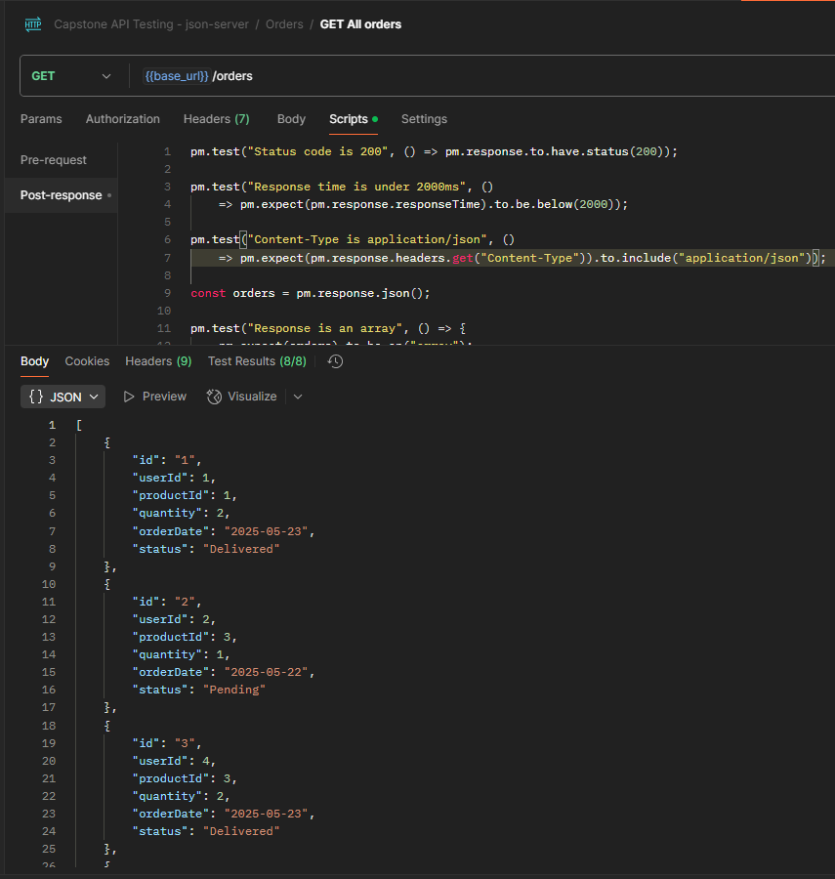
API Testing Using Postman
Sample Get
Sample Get All
File Structure

Slide 27
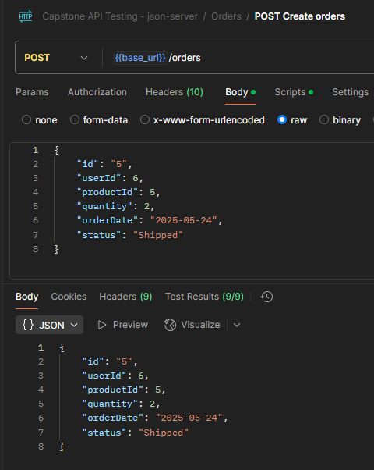
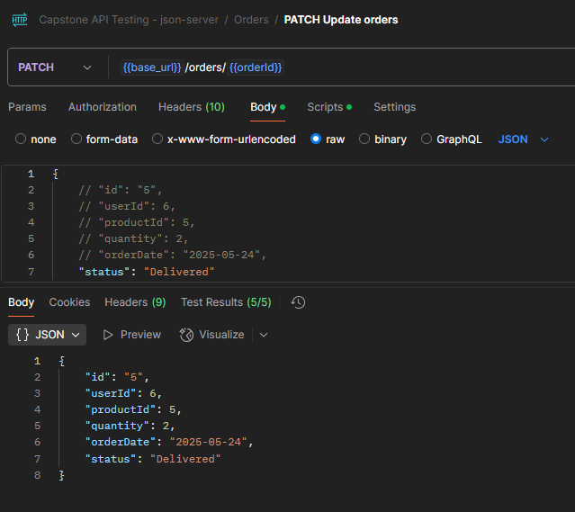
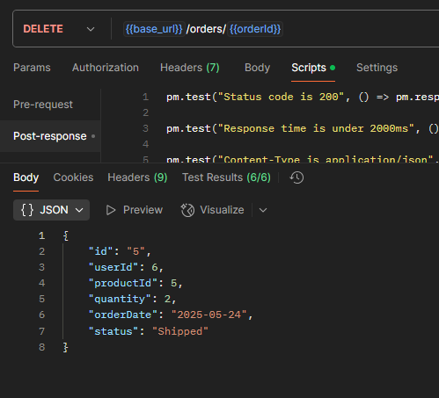
API Testing Using Postman
Sample Delete
Sample Patch
Sample Post

Slide 28
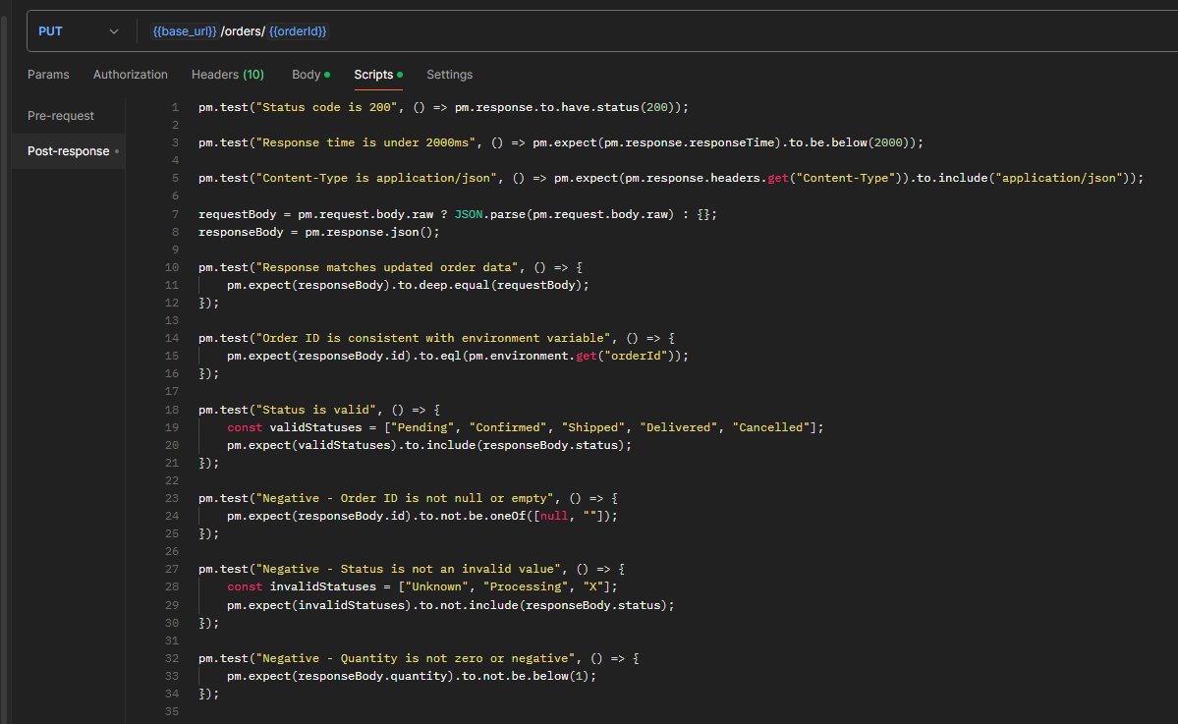
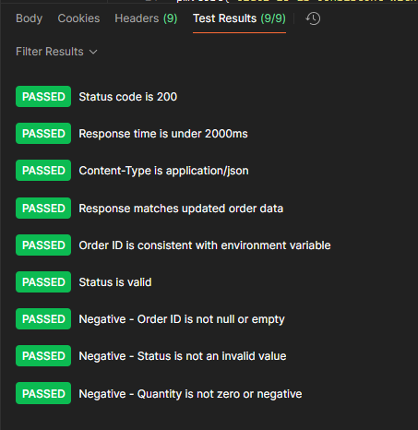
API Testing Using Postman
Sample Validation Script for PUT
Sample Test Result

Slide 29
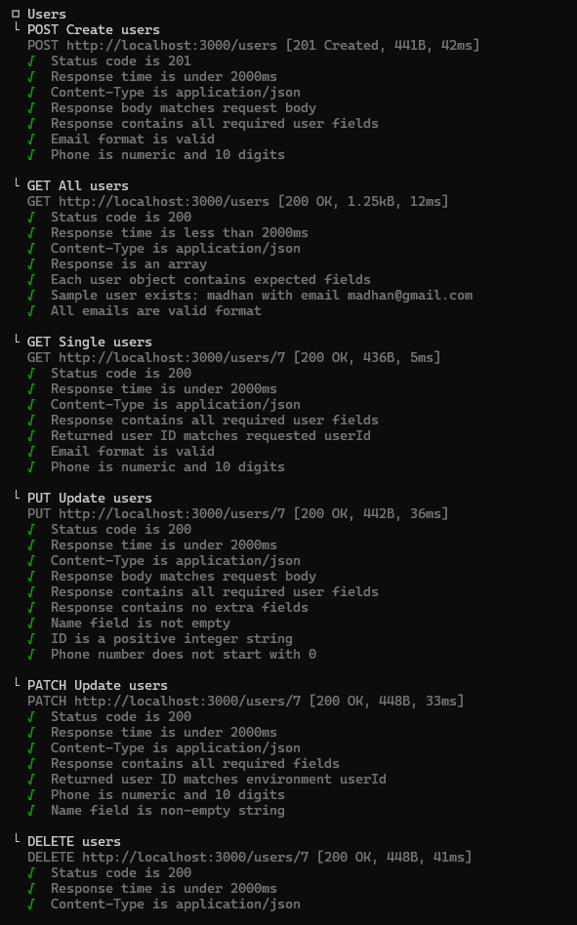
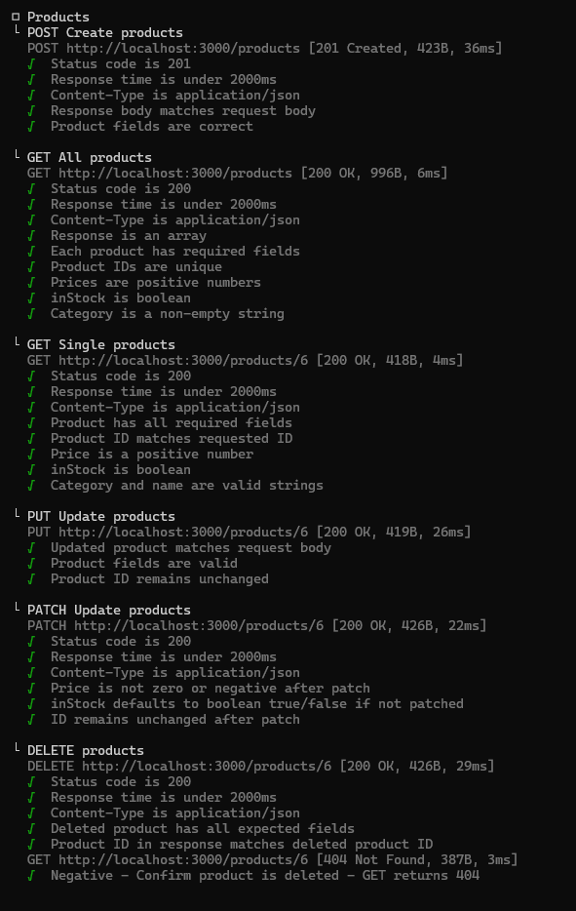
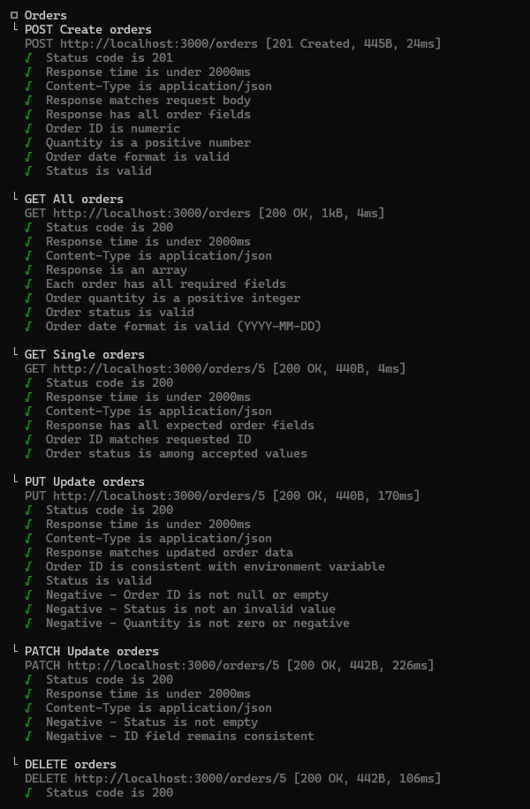
API Testing Using Newman
Users Assertions
Products Assertions
Orders Assertions

Slide 30
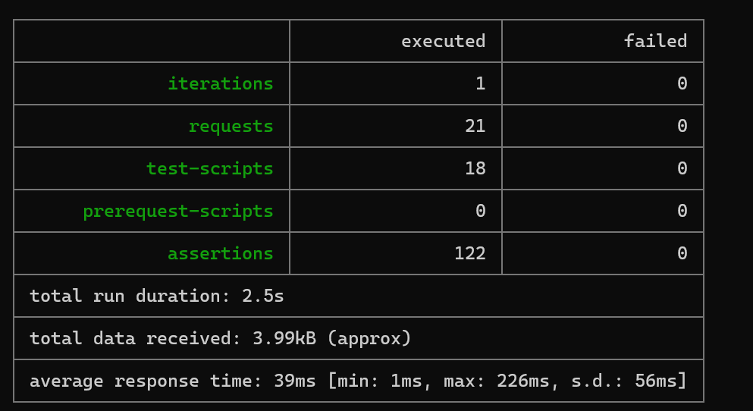
API Testing Using Newman

Slide 31
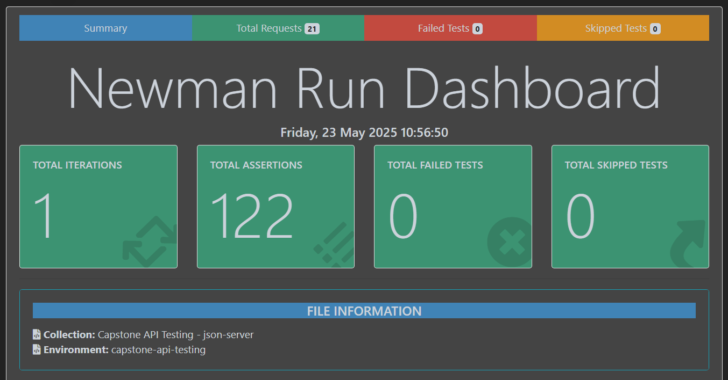
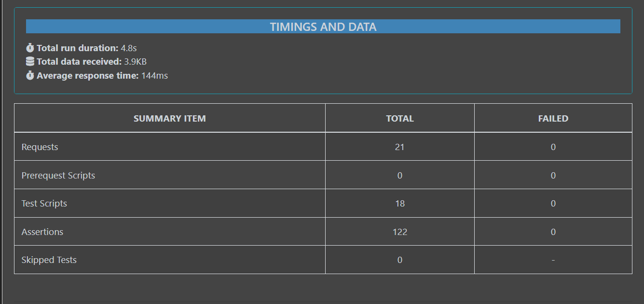
API Testing Using Newman - Reports

Slide 32
JMeter
1) Tested 5 API endpoints of takeuforward.org (4 GET, 1 POST). GET : Home Page, Contact-us, About-us, Striver A2Z sheet Page
POST: Login Page
2) Captured performance metrics and generated HTML reports

Slide 33
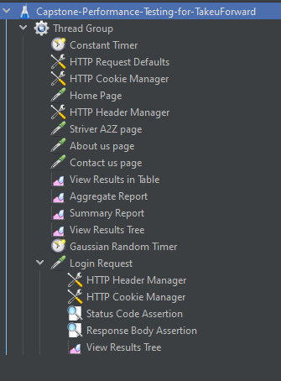
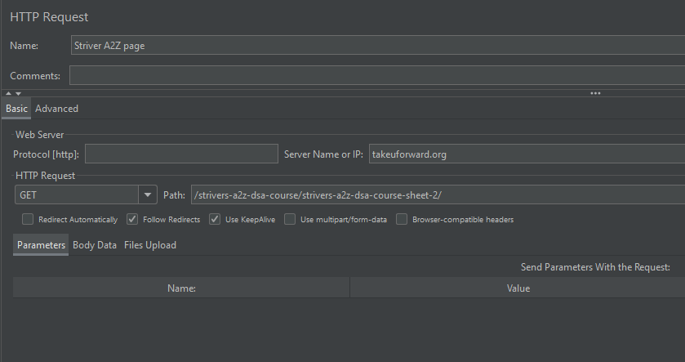
JMeter - Sampler
Sample GET request - to Striver A2Z sheets in TakeuForward
File Structure

Slide 34
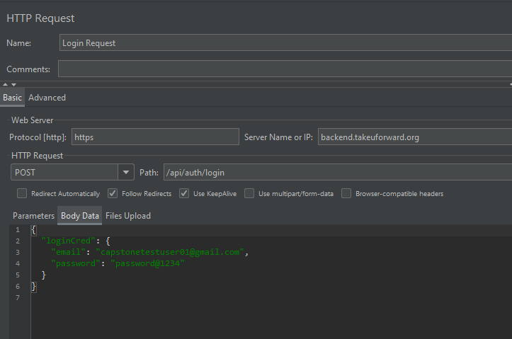
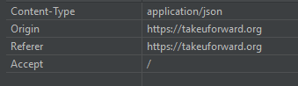
JMeter - Sampler
Sample Header
Sample POST request - to login in TakeuForward

Slide 35
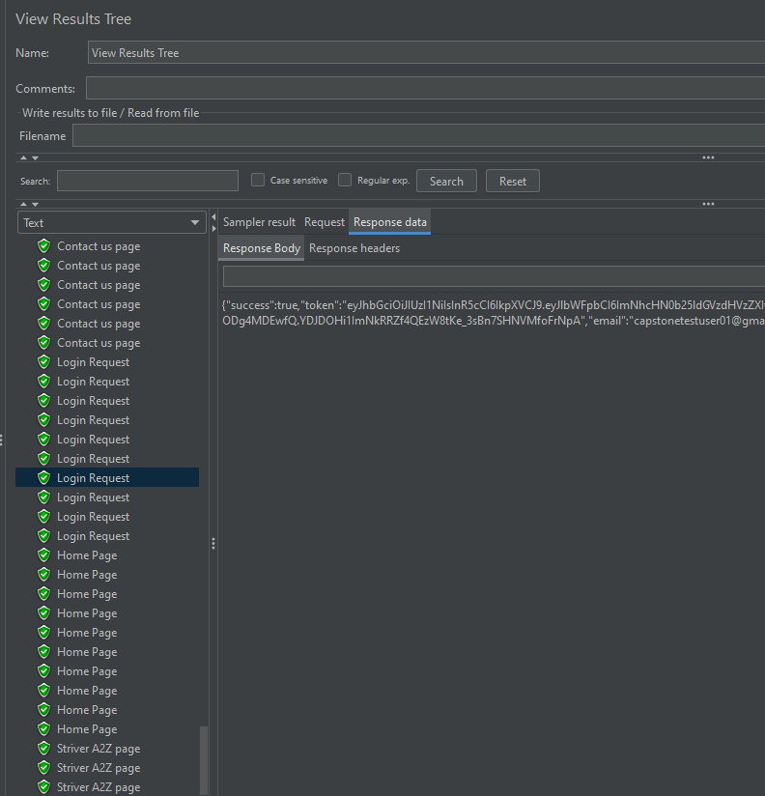
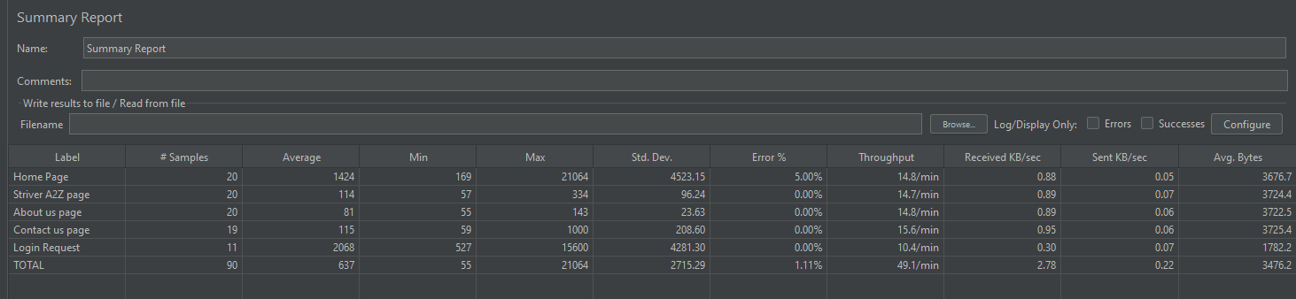
JMeter - Listeners
Summary Report
View Results Tree

Slide 36
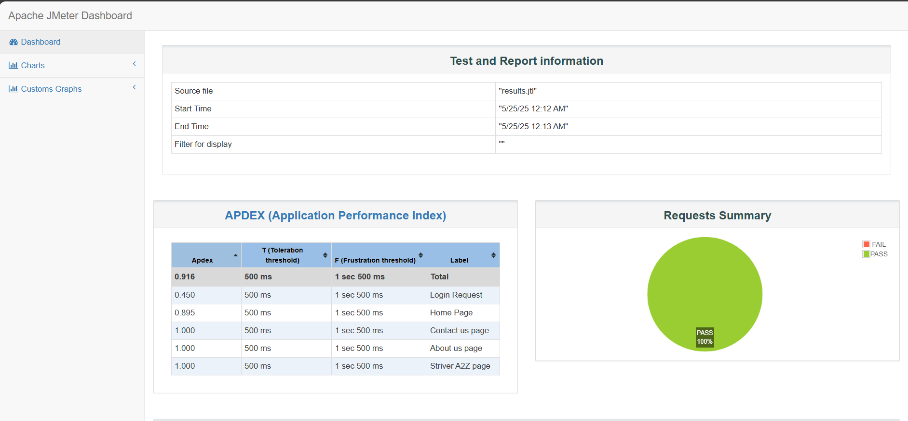
JMeter - Reports

Slide 37
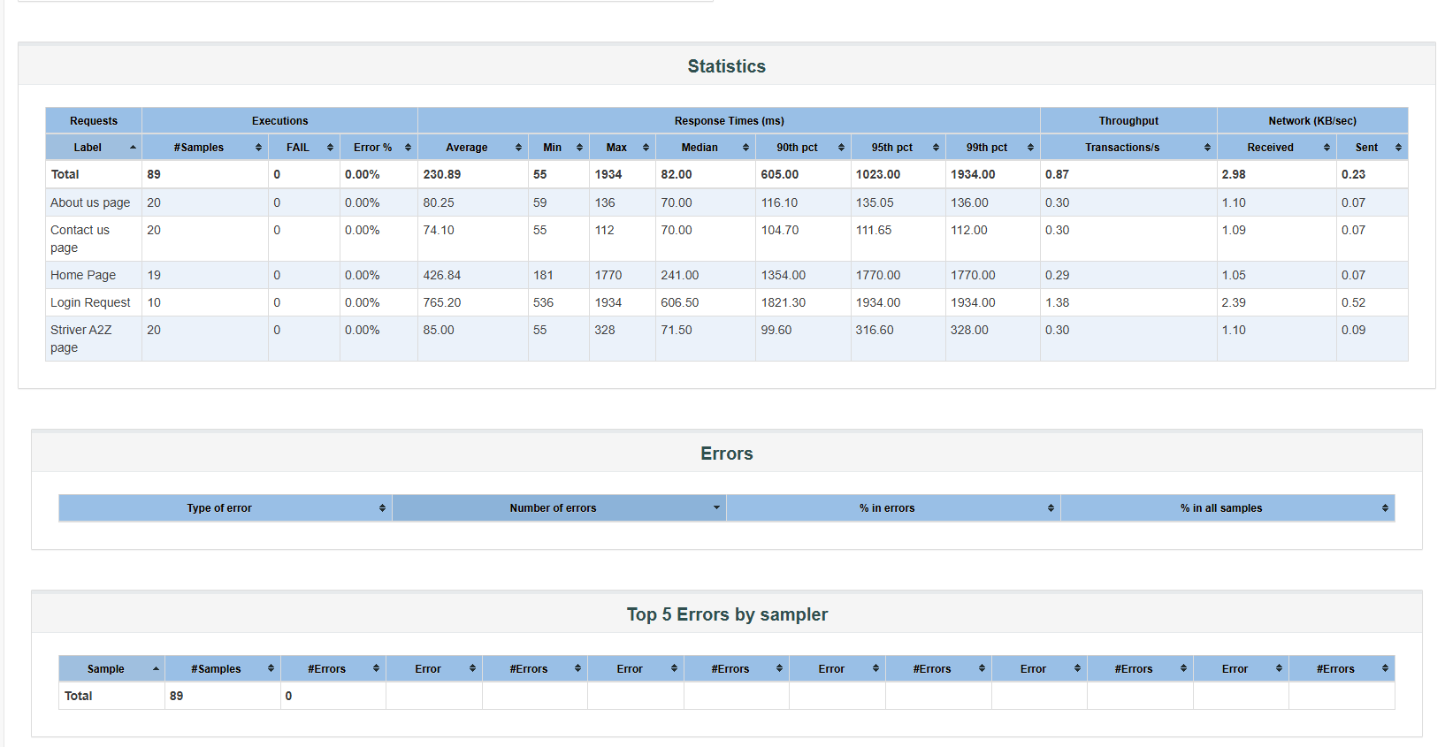
JMeter - Reports

Slide 38


Jenkins
1) Automated Selenium test execution via Jenkins
2) Configured trigger for scheduled builds

Slide 39

Github
1) Pushed all project code to GitHub
2) Used branches for each module/topic for better version control
Github Repository Link:
madhanadithya/madhanadithya-Capstone-hp-training-may2025

Slide 40
Challenges Faced
While using json-server, when we create data using a POST request, the generated id is automatically converted from an integer to a string. This makes establishing relationships between endpoints difficult. GET {base_url}/orders/{id}?_expand=user&_expand=product
session between the tests to maintain the workflow.

Slide 41
Conclusion
I have learnt about end-to-end automation using Selenium for web UI, Postman and Newman for API testing, JMeter for performance testing, Jenkins for CI/CD integration, and Jira for managing sprints, test cases, and tracking execution.
This project helped me understand how to design, execute, and manage real-time test scenarios effectively using industry-standard tools.

Slide 42
Thank You

